Slide 1
Introduction to Public Health
Module # 3
Concept of disease and disease prevention
DR. SHAIKH ABDUS SALAM
Dept. of Public Health
North south University

Slide 2
OBJECTIVES OF THE LECTURE
By the end of this lecture you will be able to:
Identify measures for prevention and control of communicable diseases
  Measures towards reservoir
  Measures towards the MOT /environment
  Measures to contacts and susceptible host
Identify the levels of prevention of diseases
September 22, 2014

Slide 3
COMMUNICABLE DISEASES
An illness due to a specific infectious agent or it’s toxic products capable of being directly or indiectly transmitted from man to man, animal to man or from the environment to man or animal.
Dr. Shaikh Abdus Salam

Slide 4
COMMUNICABLE DISEASES
Source: The source of infection is defined as “the person, animal, object or substance from which an infectious agent passes or is disseminated to the host”.
Reservoir: A Reservoir is defined as “any person, animal,arthropode,plant,soil or substance(or combination of these)in which an infectious agent lives and multiplies, on which it depends primarily for survival, and where it reproduces itself in such manner that it can be transmitted to a susceptible host”.
In short ,the reservoir is the natural habit in which the organism metabolizes and replicates.
Dr. Shaikh Abdus Salam

Slide 5
COMMUNICABLE DISEASES
CASES:A case is defined as “a person in the population or study group identified as having the particular disease, health disorder or condition under investigation".
A variety of criteria (e.g., clinical, biochemical laboratory)may be used to identify cases.
(b)Intestinal
Dr. Shaikh Abdus Salam

Slide 6
CARRIER
:A carrier is defined as “an infected person or animal that harbours a specific infectious agent in the absence of discernible clinical .disease and serves as a potential source of infection for other”
Dr. Shaikh Abdus Salam

Slide 7
Mode of Transmission:
Mode of Transmission: a) Direct Transmission
b) Indirect Transmission
Dr. Shaikh Abdus Salam

Slide 8
Mode of Transmission:
A. Direct Transmission
1.Direct contact.
2.Droplet infection.
3.Contact with soil
4.Inoculation into skin or mucosa
5.Transplacental (Vertical)
Dr. Shaikh Abdus Salam

Slide 9
Mode of Transmission:
B. Indirect Transmission
(1)Vehicle-borne
(2)Vector borne
(a)Mechanical
(b)Biological
(3)Air-Borne
(a)Droplet nuclei
(b)Dust.
(4)Fomite-borne
(5)Unclean hands and fingers.
Dr. Shaikh Abdus Salam

Slide 10
PREVENTION
Is a process of protection some one from getting any health problems.
Dr. Shaikh Abdus Salam

Slide 11
Prevention
Anticipatory action taken to
  Reduce the possibility of an event or Condition occurring or developing, or
  Minimize the damage that may result from the event or condition if it does occur (Pickett & Hanlon, 1990)

Slide 12
Determinants of Prevention
Successful prevention depends upon:
  A knowledge of causation
  Dynamics of transmission
  Identification of risk factors and risk groups
  Availability of early detection and treatment measures
  An organization for applying these measures to appropriate persons or groups and
  Continuous evaluation of and development of procedures applied

Slide 13
Prevention
Actions aimed at eradicating, eliminating, or minimizing the impact of disease and disability, or if none of these is feasible, retarding the progress of disease and disability.
The concept of prevention is best defined in the context of levels of prevention; primary, secondary, and tertiary prevention.
(Oxford Dictionary 2008)
September 22, 2014

Slide 14
Control & Elimination of disease
CONTROL: Disease incidence is reduced to a minimal level, acceptable at the level of country/region, at which the disease is no longer considered a public health problem, while infection may still occur.
ELIMINATION: Reduction to zero of the incidence of a specified disease in a defined community or country or region as a result public health actions.
September 22, 2014

Slide 15

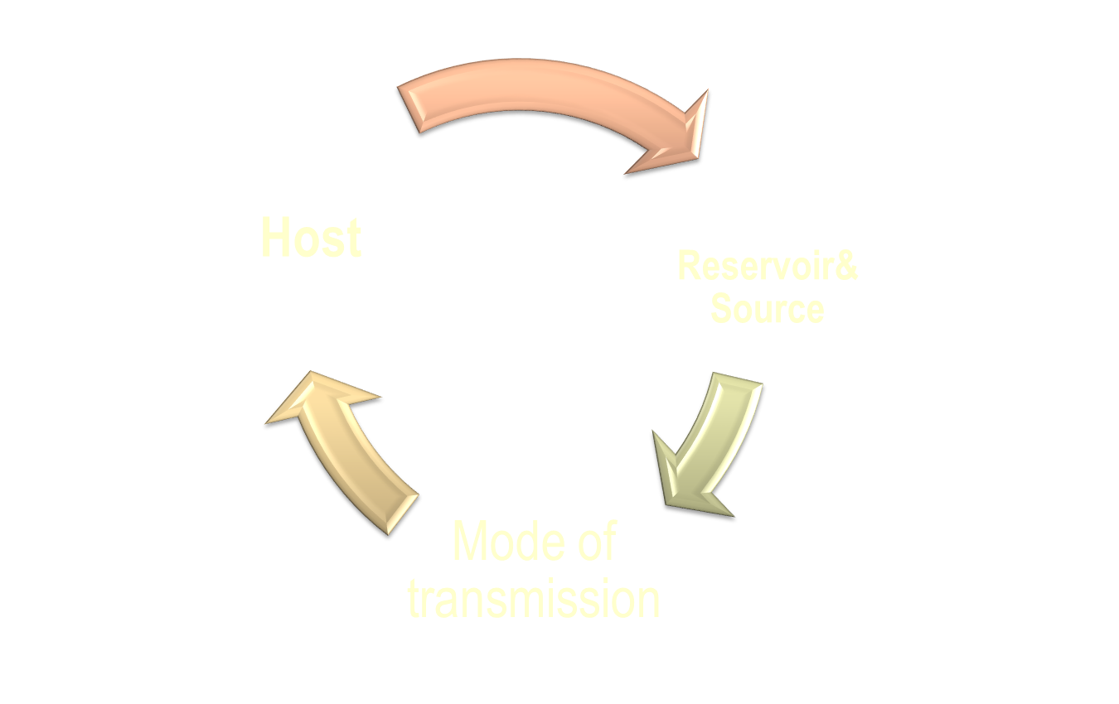
-Surveillance/quarantine
-Chemoprophylaxis
Sero-prophylaxis
Vaccination
-Isolation of cases
-Treatment
-Disinfection
-Control of carriers
-Control of animals
-Prevention of overcrowding
-Personal hygiene
-Vector control
-Environmental sanitation
September 22, 2014

Slide 16
Measures towards Reservoir
Objective of control measures towards reservoir
Reduce quantity of agent (complete or partial reduction)
Reduce communicability
Measures towards cases
Measures towards carriers
Measures towards animal reservoir
September 22, 2014

Slide 17
Measures towards cases
Case finding (early detection/screening)
Reporting
Segregation /isolation of cases
Treatment of cases
Disinfection
September 22, 2014

Slide 18
Measures towards cases
Segregation/Isolation of cases
This means that the patient is isolated from the community in a fashion that prevents direct or indirect spread of infectious agents.
Isolation is usually done for a period which equals the “period of communicability” at a hospital (fever hospital) or at home. Ideally repeated negative sample are needed before his release.
September 22, 2014

Slide 19
Measures towards cases
Treatment of cases
Early diagnosis and prompt treatment of infections with appropriate regimens (e.g. antibiotics, antiviral or other chemotherapeutic agents) helps reducing communicability.
September 22, 2014

Slide 20
Measures towards cases
Disinfection
  -Concurrent
  -Terminal
Disinfection of the soiled articles by the patient discharges or excreta concurrently (during his presence as source of infection) and/or terminally (after his discharge from the hospital or death) helps in reduction of communicability.
Disinfection of contaminated objects with appropriate “enteric precautions,” “respiratory precautions,” “universal precautions”
September 22, 2014

Slide 21
Measures applied to carriers
Detection of carriers:
  If they represent important reservoir of infection.
  If they were suspected in a closed community, such as boarding schools, army barracks, food handling places,…..
Exclusion from work: in certain occupations for example;
  food handler (e.g. Typhoid carrier) or a
  teacher (e.g. Diphtheria carrier).
Treatment for the carrier state (when applicable).
September 22, 2014

Slide 22
Measures applied to animal reservoir
Inspection and slaughtering of infected animals (in bovine tuberculosis)
Testing and immunization of uninfected sheep, cattle (in brucellosis)
Careful husbandry and sterilization of animal products (in anthrax).
Extinction/Destruction of animal reservoir has been successful with diseases as rabies and bovine TB in several countries. Such procedure is only possible for domestic animals while it is difficult or almost impossible for wild animals (e.g. in jungle yellow fever,….)
September 22, 2014

Slide 23
Measures to Contacts/ susceptible Host
Surveillance/observation
Quarantine
Increasing resistance of susceptibles
September 22, 2014

Slide 24
Measures to Contacts/ susceptible Host
Surveillance means close medical supervision of the contacts, without restricting their movement, for the purpose of early detection of the disease in question.
Surveillance should be done for duration of the longest “incubation period” of the disease counted from date of last exposure.
September 22, 2014

Slide 25
Choice of appropriate prevention & control measures
The choice of the control measure is disease dependent.
It depends upon the knowledge of:
  Natural history, causation and dynamics of disease transmission
  identification of risk factors and high risk groups
  availability of tools of intervention (vaccine chemoprophylaxis or treatment,..)
September 22, 2014
Notes:
19/2/2007
Dr. Salwa Tayel

Slide 26
Measures towards the environment
Vector control (insecticides, indoor or aerial spraying, mosquito-nets,…..
National and international measures: which include different public health measures undertaken within and between countries in order to protect the individuals and communities from communicable diseases.
September 22, 2014

Slide 27
Measures towards the environment
Reduction of overcrowding (better housing conditions, proper ventilation)
Personal hygiene (cleanliness, hand washing, regular bathing)
Environmental sanitation: (e.g. sanitary sewage disposal, sanitary refuse disposal, safe water supply,…)
September 22, 2014

Slide 28
Eradication
It means worldwide disappearance of a disease i.e. (permanent reduction to zero level) :
The organism may be present only in laboratories, but there is no need for public health actions. e.g. smallpox since 1979.
September 22, 2014

Slide 29
Level of Prevention
Primordial Prevention
Primary Prevention
Secondary Prevention
Tertiary Prevention
Dr. Shaikh Abdus Salam

Slide 30
Primordial Prevention
Primordial prevention, a new concept, is receiving special attention in the prevention of chronic disease. This is primary prevention in its purest sense, that is, prevention of the emergence or development of risk factors in countries or population groups in which they have not yet appeared. In primordial prevention, efforts are directed towards discouraging children from adopting harmful lifestyles. The main intervention in primordial prevention is through individual and mass education.
Dr. Shaikh Abdus Salam

Slide 31
Primary Prevention
Primary prevention can be defined as “action taken prior to the onset of disease will ever occur”. Primary prevention is far more than averting the occurrence of a disease and prolonging life. It includes the concept of “positive health”, a concept that encourages achievement and maintenance of “an acceptable level of health that will enable every individual to lead a socially and economically productive Life”. It concerns an individual’s attitude towards life and health and the initiative ha takes about positive and responsible measures for himself, his family and his community.
Dr. Shaikh Abdus Salam

Slide 32
Secondary Prevention
Secondary prevention can be defined as “action which halts the progress of a disease at its incipient stage and prevents complications”. The specific interventions are early diagnosis (e.g., screening tests, case finding programmes) and adequate treatment. Secondary prevention is largely the domain of clinical medicine. The health programmes initiated by Governments are usually at the level of secondary prevention. The secondary prevention is an imperfect tool in the control of transmission of disease.
Dr. Shaikh Abdus Salam

Slide 33
Tertiary Prevention
When the disease process has advanced beyond its early stages, it is still possible to accomplish prevention by what might be called “tertiary prevention”. Tertiary prevention can be defined as “all measures available to reduce or limit impairments and disabilities, minimize suffering caused by existing departures from good health and to promote the patients adjustment to irremediable conditions”.
Dr. Shaikh Abdus Salam

Slide 34
Cocept of Control
The term “disease control” describes operations aimed at reducing the:
a) incidence of disease
b) the duration and the risk of transmission of disease
c) effects of infection
d) financial burden to the community
e.g # malaria control, TB control etc
Dr. Shaikh Abdus Salam

Slide 35
Control of communicable Diseases
Control measures:
A. Measures taken at individual / personal level.
B. Measures taken at community level.
Dr. Shaikh Abdus Salam

Slide 36
Control of communicable Diseases
Personal level measures:
1) Attention to cases
2) Attention to contacts
3) Attention to carriers
Dr. Shaikh Abdus Salam

Slide 37
Control of communicable Diseases
B. Measures taken at community level:
1) Vaccination/ Immunization
2) Mass chemotherapy
3) environmental control
4) Surveillance
5) Personal hygiene
6) Personal protection
7) Health education
Dr. Shaikh Abdus Salam

Slide 38
THANK YOU
Dr. Shaikh Abdus Salam

